Slide 1


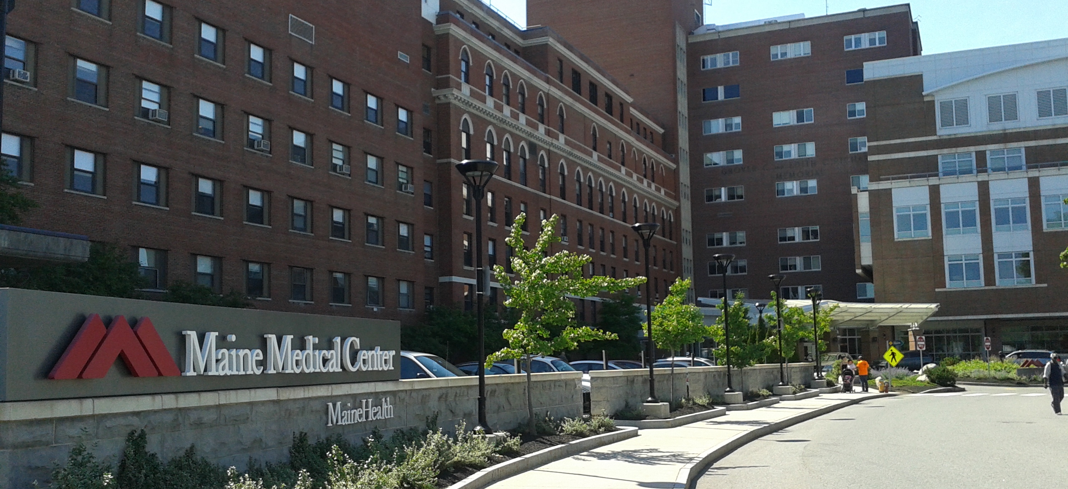
MAINEHEALTH INSIGHT SLIDES

Slide 2


Moving Local Healthcare
From Wall Street to Maine Street

Slide 3
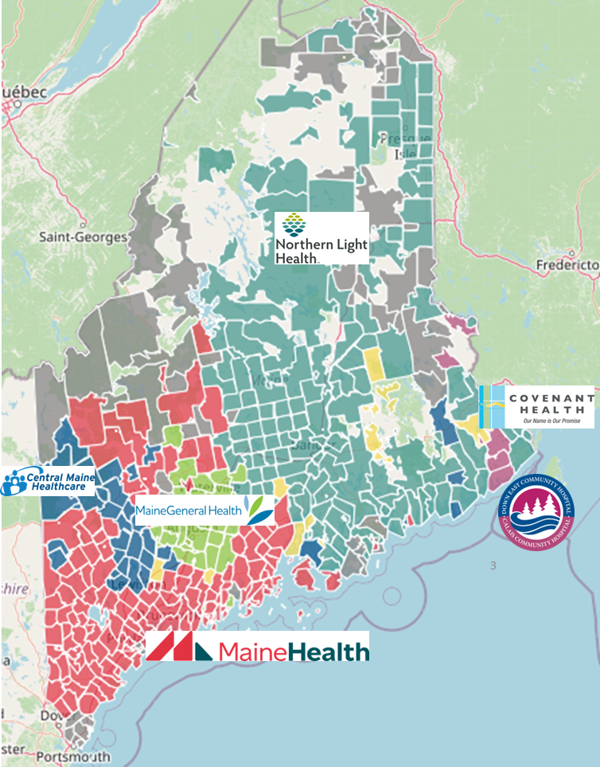
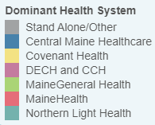
Market Share by Zip Code
Modeled from Medicare Patient Zip Code Data

Slide 4
MaineHealth is at the Center of Employer Demand
Companies Headquartered by
County With 50+ Employees
Self Funded
273K
75
PLAN GROWTH POTENTIAL
548K
Insured
22
46
164
28
29
Working Age
798K
57
144
39
60
117
43
65
568
42
182
Population
1,367K
Number of Companies
100
200
300
400
500

Slide 5
MaineHealth is Patient Recommended
Health System | HCAHPS Recommendation Percentile | CMS Stars Percentile | Mortality Percentile | Readmission Percentile | KBA Brand Quality Score
MaineHealth | 63 | 84 | 77 | 80 | 67
Covenant Health (MA) | 80 | 72 | 67 | 63 | 72
Other Independent Hospitals | 70 | 64 | 62 | 68 | 69
MaineGeneral Health | 59 | 100 | 61 | 87 | 64
Northern Light Health | 49 | 78 | 70 | 80 | 61
Central Maine Healthcare | 37 | 61 | 57 | 85 | 57

Slide 6

State-wide Plan Size
Control
Transformation
$
Margin
$
Volume/Profit
Steerage to MaineHealth
Beneficial Pricing

Slide 7
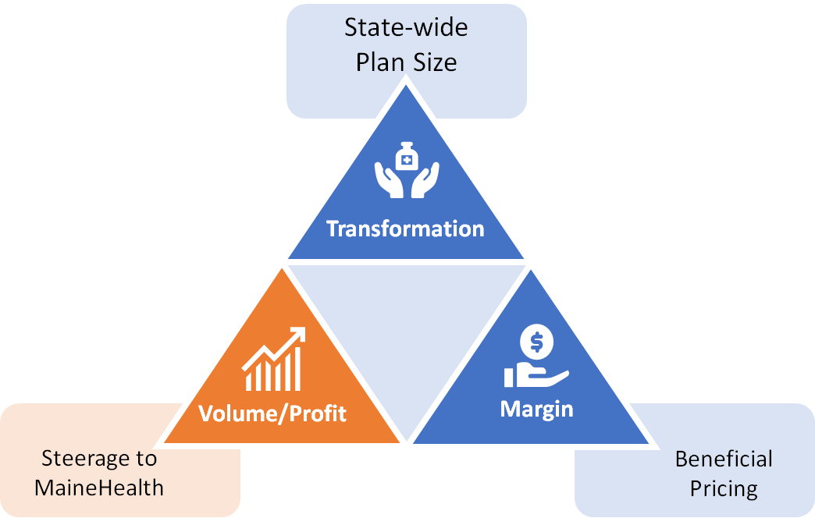

Traditional Volume-Based DTE
Year | Target Employees | Target Members
1 | 500 | 900
2 | 1,000 | 1,800
3 | 1,700 | 3,100
4 | 2,500 | 4,500
5 | 3,700 | 6,700
6 | 5,200 | 9,400
7 | 7,100 | 12,800
8 | 9,400 | 16,900
9 | 12,300 | 22,100
10 | 15,800 | 28,400
11 | 19,700 | 35,500
12 | 24,100 | 43,400
13 | 28,600 | 51,500
14 | 33,300 | 59,900
15 | 37,700 | 67,900
16 | 41,700 | 75,100
17 | 45,100 | 81,200
18 | 48,000 | 86,400
19 | 50,400 | 90,700
20 | 52,200 | 94,000
21 | 53,600 | 96,500
22 | 54,600 | 98,300
23 | 55,400 | 99,700
24 | 56,000 | 100,800
25 | 56,400 | 101,500
Early Stage
Gaining Name Recognition, Early Growth
New Revenue:
New Profit:
$15.31M
$1.73M
Growth Stage
Strong Reputation, Strong Growth
New Revenue:
New Profit:
$106.68M
$13.26M
Mature Stage
High Profitability, Market Saturation
New Revenue:
New Profit:
$212.54M
$26.58M

Slide 8
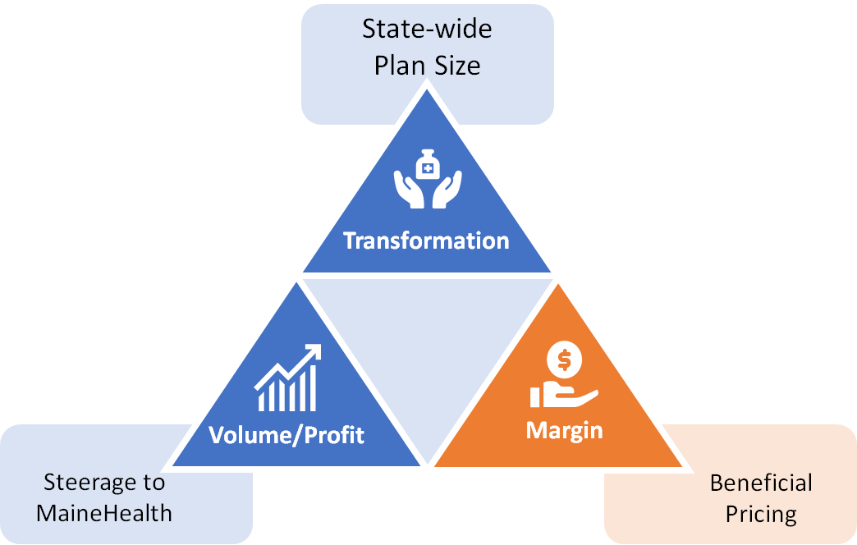
Margin-Focused DTE
Year | Target Employees | Target Members
1 | 100 | 200
2 | 200 | 400
3 | 300 | 500
4 | 400 | 700
5 | 600 | 1,100
6 | 900 | 1,600
7 | 1,200 | 2,200
8 | 1,600 | 2,900
9 | 2,100 | 3,800
10 | 2,600 | 4,700
11 | 3,300 | 5,900
12 | 4,000 | 7,200
13 | 4,800 | 8,600
14 | 5,500 | 9,900
15 | 6,300 | 11,300
16 | 6,900 | 12,400
17 | 7,500 | 13,500
18 | 8,000 | 14,400
19 | 8,400 | 15,100
20 | 8,700 | 15,700
21 | 8,900 | 16,000
22 | 9,100 | 16,400
23 | 9,200 | 16,600
24 | 9,300 | 16,700
25 | 9,400 | 16,900
Early Stage
Gaining Name Recognition, Early Growth
New Revenue:
New Profit:
$2.55M
$0.37M
Growth Stage
Strong Reputation, Strong Growth
New Revenue:
New Profit:
$17.78M
$3.75M
Mature Stage
High Profitability, Market Saturation
New Revenue:
New Profit:
$35.42M
$7.63M

Slide 9
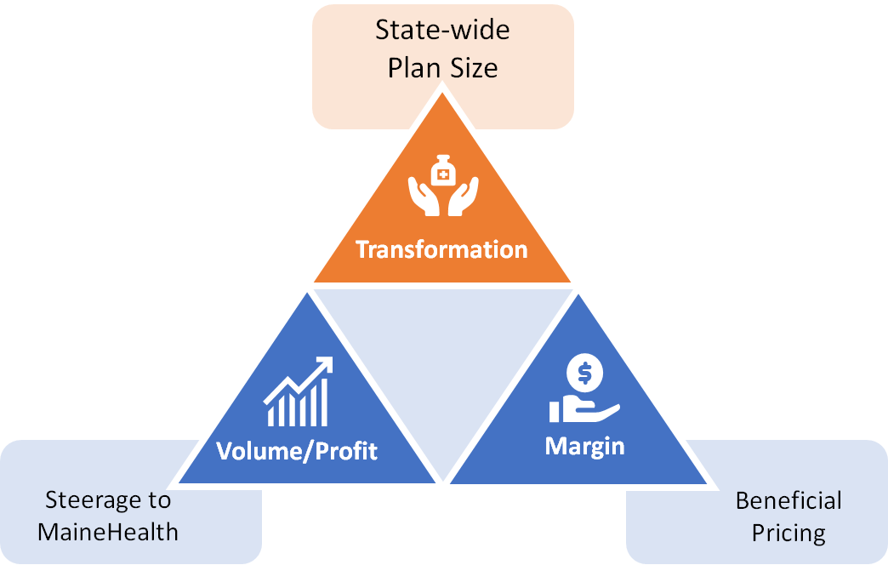
State-Wide DTE
Early Stage
Gaining Name Recognition, Early Growth
Year | Employees | Members
1 | 9,100 | 20,020
2 | 18,300 | 40,260
3 | 27,600 | 60,720
4 | 38,200 | 84,040
5 | 49,600 | 109,120
6 | 61,300 | 134,860
7 | 72,900 | 160,380
8 | 83,600 | 183,920
9 | 93,200 | 205,040
10 | 101,400 | 223,080
New Revenue:
New Profit:
$0M
$0M
Growth Stage
Strong Reputation, Strong Growth
New Revenue:
New Profit:
$0M
$0M
Mature Stage
High Profitability, Market Saturation
Target of reaching 20% of the population in 10 years.
New Revenue:
New Profit:
$0M
$0M

Slide 10
Traditional Value-Based Care is Backwards

Slide 11

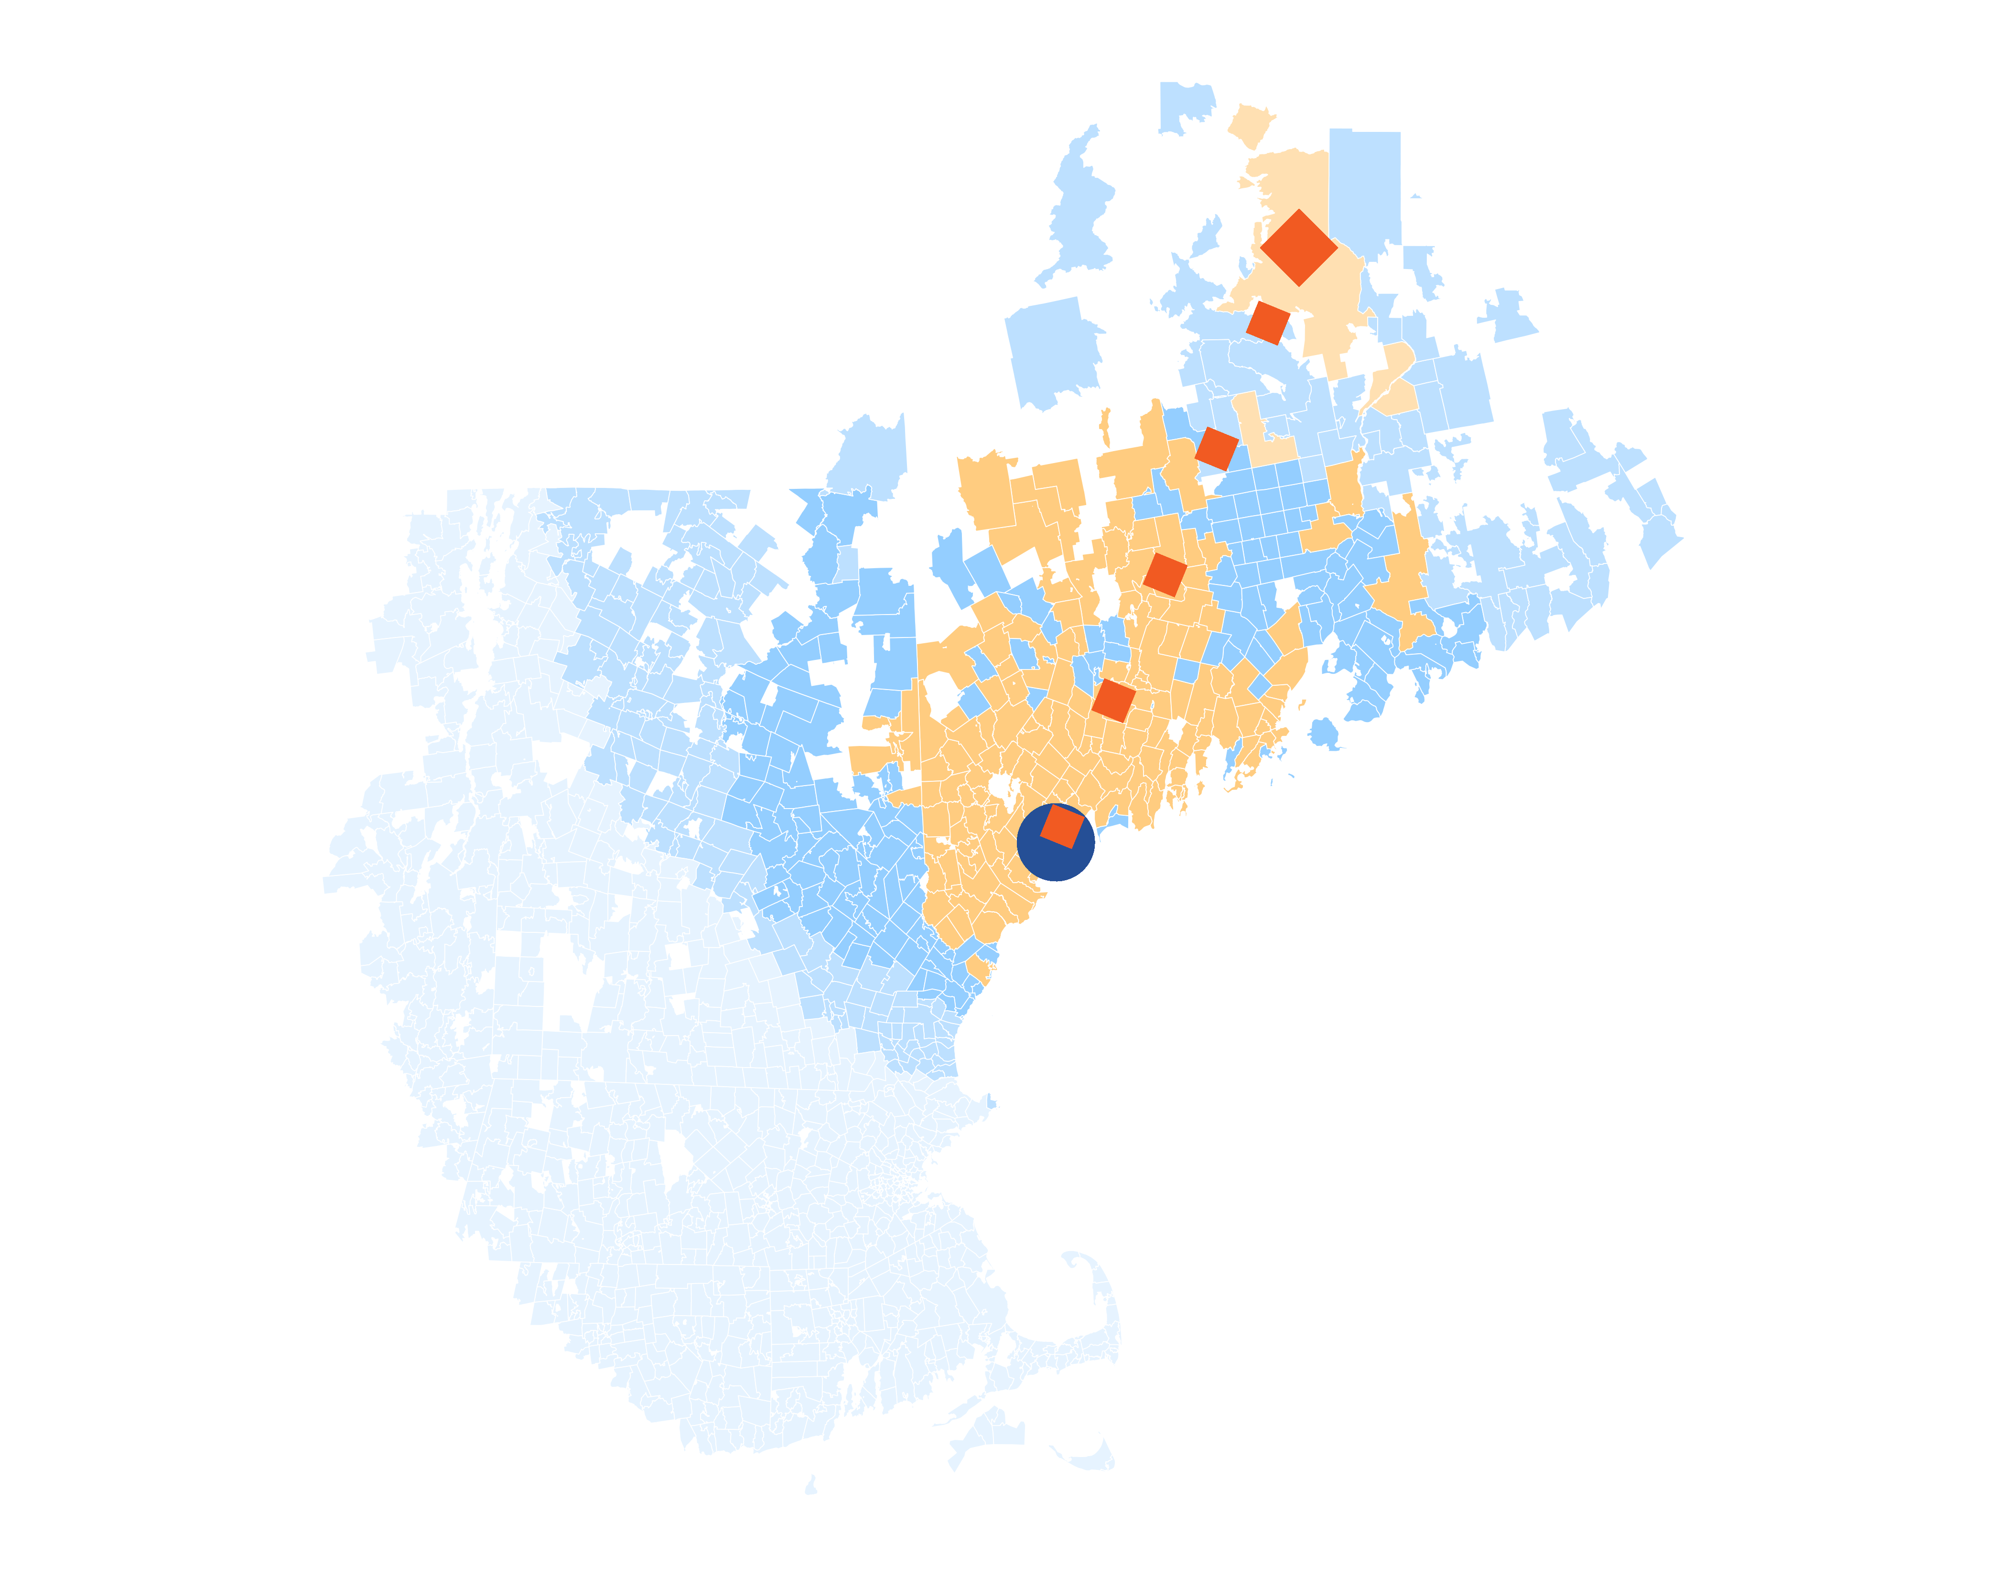
Patients are Driving
Further to Reach
MaineHealth
14 patients (admissions) traveled 272.4 miles to Maine Medical Center despite 34 closer hospitals.
A probabilistic model of patient zip codes in the Medicare HSAF data reveals that MaineHealth brand quality is attracting patients from farther away than expected.

Slide 12
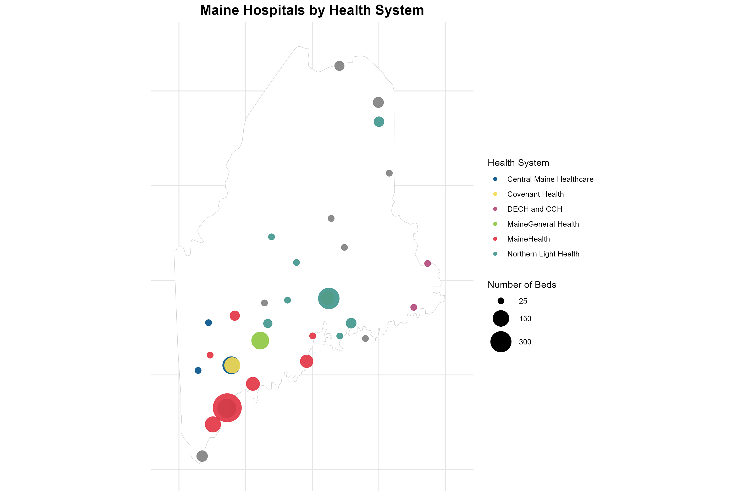

Slide 13
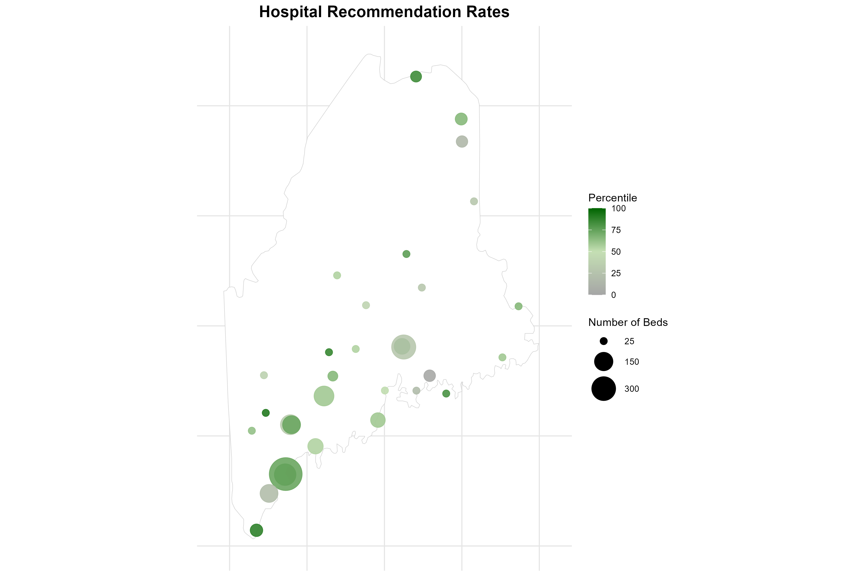

Slide 14
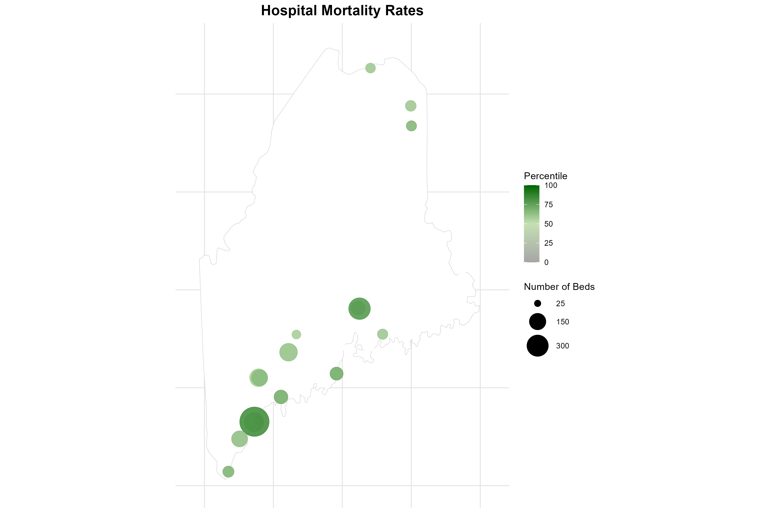
Hospitals with incomplete data are not plotted

Slide 15
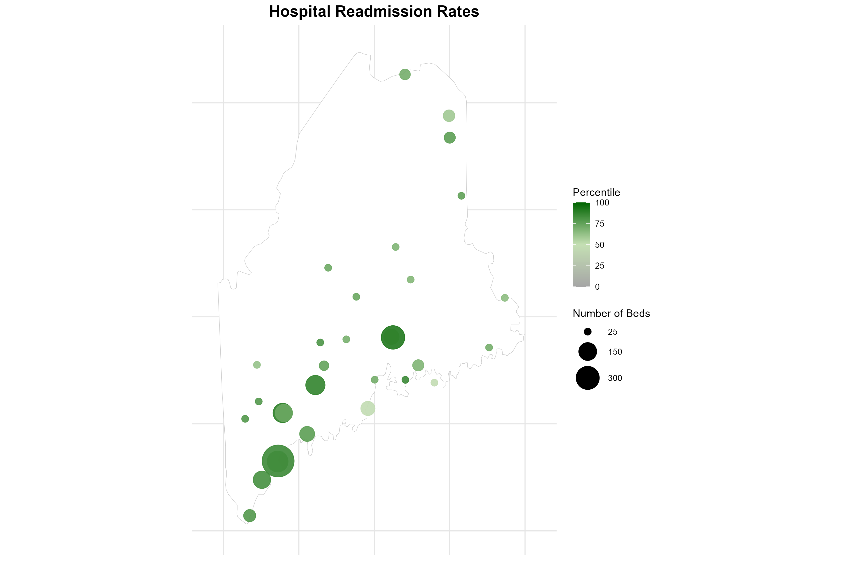

Slide 16
Other Insights

Slide 17
Companies by County
Companies Headquartered by County With 50+ Employees
75
22
46
164
28
29
57
144
39
60
117
43
65
568
42
182
Number of Companies
100
200
300
400
500

Slide 18
Companies with 50-200 Employees
Companies with 50-200 Employees
60
17
35
119
23
22
45
104
33
48
89
37
52
428
34
148
Number of Companies
100
200
300
400

Slide 19
Companies with 201-500 Employees
Companies with 201-500 Employees
13
4
7
26
2
7
6
30
5
9
18
3
10
100
7
25
Number of Companies
25
50
75
100

Slide 20
Companies with 501-1000 Employees
Companies with 501-1000 Employees
2
1
2
14
2
0
2
8
1
0
8
2
2
27
0
7
Number of Companies
0
5
10
15
20
25

Slide 21
Companies with 1001-3000 Employees
Companies with 1001-3000 Employees
0
0
1
4
0
0
2
1
0
3
2
1
1
8
0
2
Number of Companies
0
2
4
6
8

Slide 22
Companies with 3001+ Employees
Companies with 3001+ Employees
0
0
1
1
1
0
2
1
0
0
0
0
0
5
1
0
Number of Companies
0
1
2
3
4
5

Slide 23
Total Employees in Maine Counties
Total Employees at Companies with 50+ Employees
13,550
4,275
14,325
42,475
8,548
5,200
16,525
31,500
6,625
15,150
27,425
9,175
13,500
124,750
13,000
36,500
Number of Employees
25,000
100,000

Slide 24
Employees in Companies with 50-200 Employees
Employees in Smaller Companies with 50-200 Employees
7,500
2,125
4,375
14,875
2,875
2,750
5,625
13,000
4,125
6,000
11,125
6,500
53,500
4,250
4,625
18,500
Number of Employees
10,000
20,000
30,000
40,000
50,000

Slide 25
Employees in Companies with 201-500 Employees
Employees in Medium-Sized Companies with 201-500 Employees
4,550
1,400
2,450
9,100
700
2,450
2,100
10,500
1,750
3,150
6,300
3,500
35,000
2,450
1,050
8,750
Number of Employees
10,000
20,000
30,000

Slide 26
Employees in Companies with 501-1000 Employees
Employees in Medium-Large Companies with 501-1000 Employees
1,500
750
1,500
10,500
1,500
0
1,500
6,000
750
0
6,000
1,500
20,250
0
1,500
5,250
Number of Employees
0
5,000
10,000
15,000
20,000

Slide 27
Employees in Companies with 1001-3000 Employees
Employees in Large Companies with 1001-3000 Employees
0
0
2,000
8,000
0
0
4,000
2,000
0
6,000
4,000
2,000
16,000
0
2,000
4,000
Number of Employees
0
4,000
8,000
12,000
16,000

Slide 28
Employees in Companies with 3001+ Employees
Employees in Very Large Companies with 3001+ Employees (Excluding Health Systems)
0
0
4,000
0
3,473
0
3,300
0
0
0
0
0
0
0
6,300
0
Number of Employees
0
2,000
4,000
6,000

Slide 29
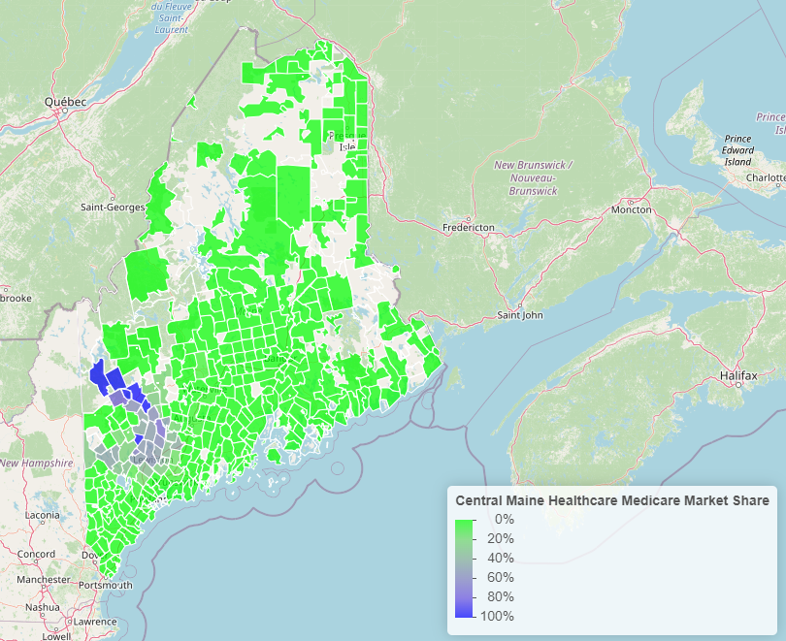
Central Maine Market Share

Slide 30
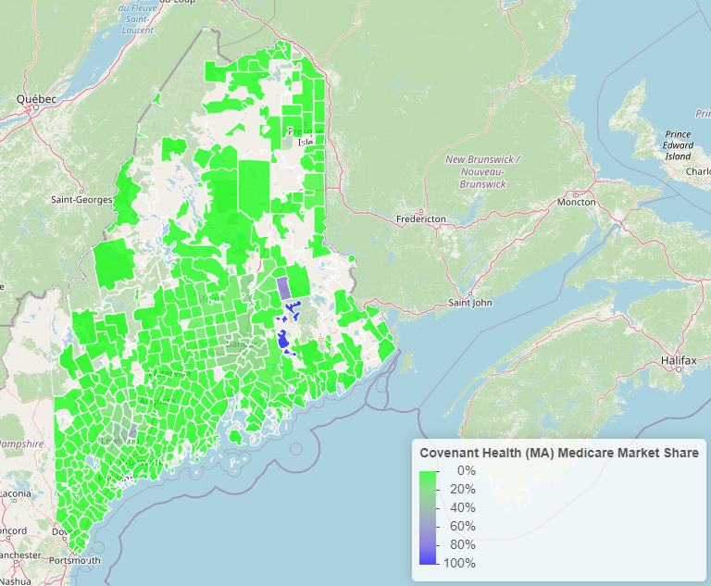
Covenant Health Market Share

Slide 31
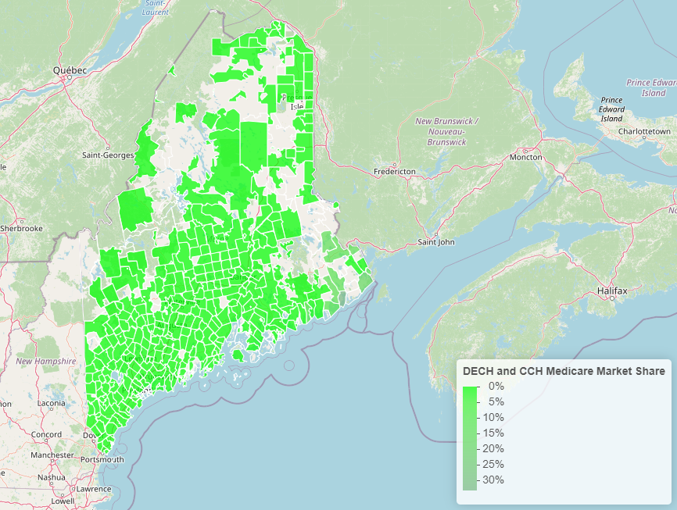
DECH and CCH Market Share

Slide 32
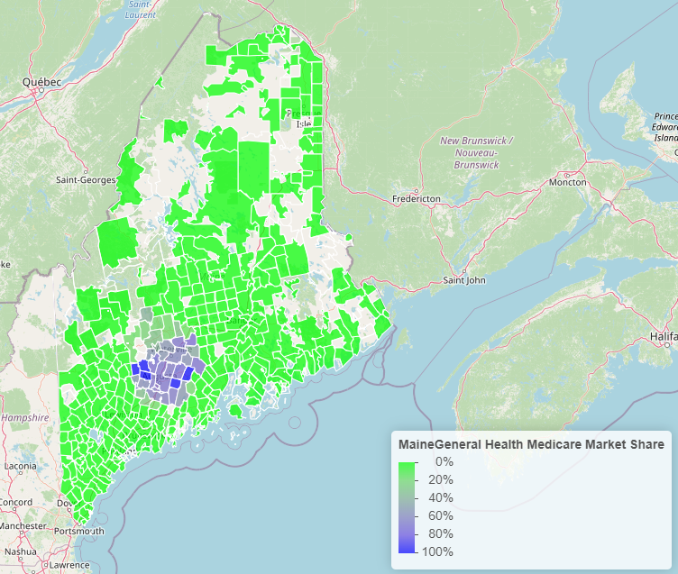
Maine General Market Share

Slide 33
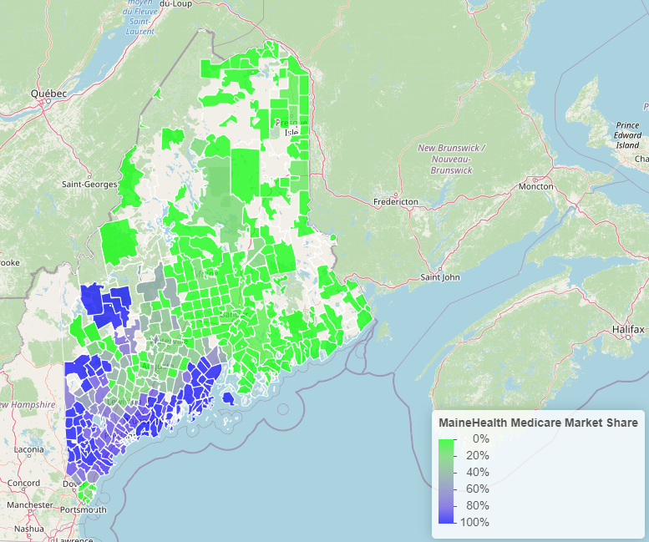
MaineHealth Market Share

Slide 34
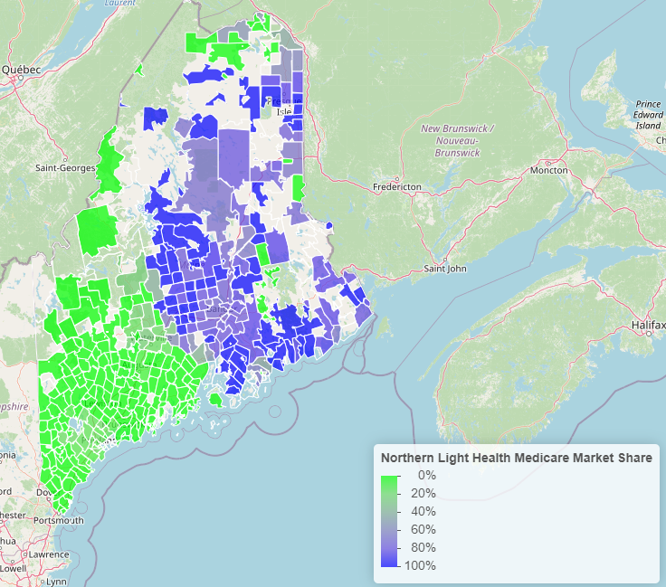
Northern Light Market Share

Slide 35
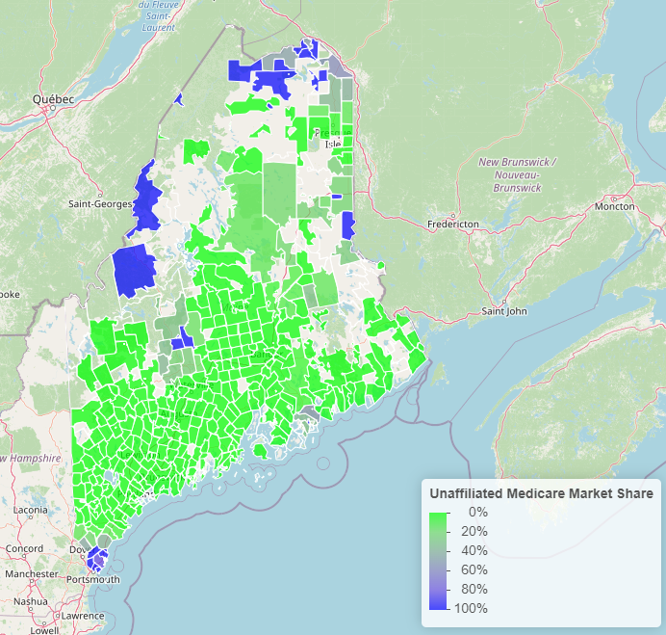
Unaffiliated Health Systems Market Share

Slide 36
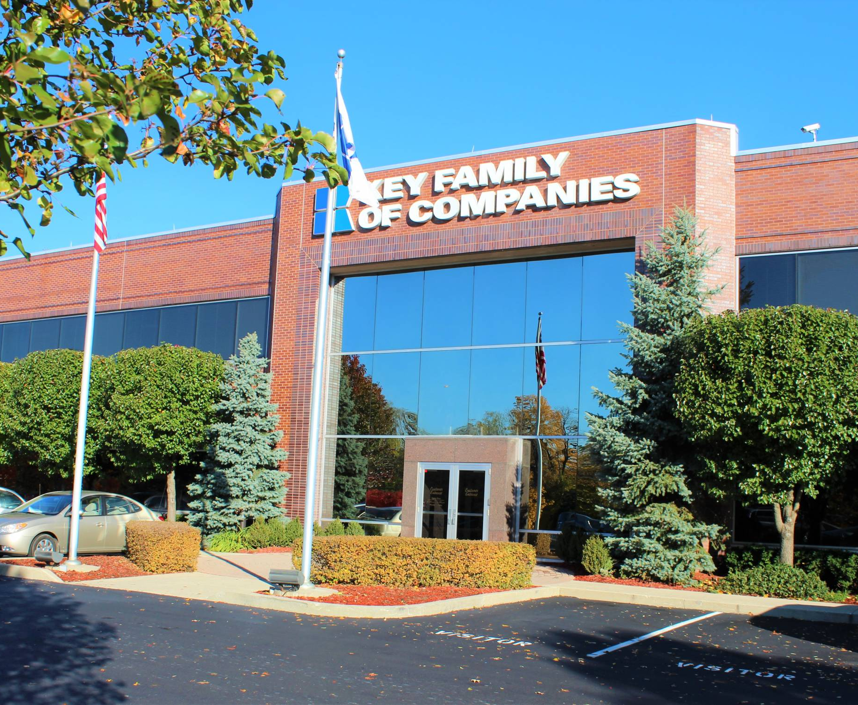
The country’s largest truly- independent TPA
3,000+ corporate clients​
3 million members under management​
700 Employees
Successful enabler of multiple private-label DTE networks
45 years of deep industry relationships ensures your health plan is easily and successfully launched
Key Benefits is the Direct-to-Employer Leader That Can Ensure Your Plan’s Success
For more information contact
Derek Moore
Senior Vice President
845-283-9973 derek.moore@keybenefit.com

